Slide 1
Explore the History and culture: Jaipur and Udaipur
Report by:
Vishudh Jain

Slide 2
How two cities are similar
Jaipur
Udaipur
Hotel 28
Indian Restaurant 19
Café 10
Historic Site 9
Bank 7
Ice Cream Shop 6
Clothing Store 6
Jewelry Store 6
not known 6
Arts & Crafts Store 5
Shopping Mall 4
Hotel 40
Indian Restaurant 17
Café 10
Restaurant 8
Resort 7
Historic Site 6
Tailor Shop 5
Bed & Breakfast 5
not known 4
Arts & Crafts Store 4
Coffee Shop 3

Slide 3
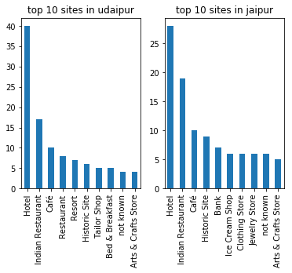
Top 10 venues in both the cities

Slide 4
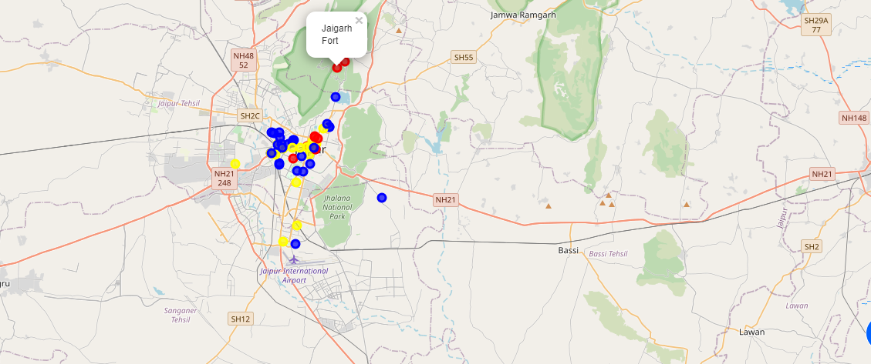
Lets look closer to Jaipur
Concentrated region of visiting places

Slide 5
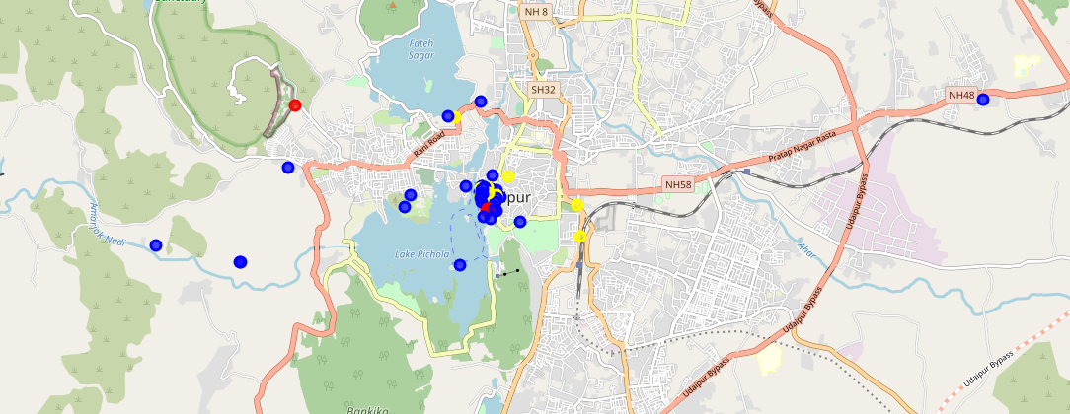
Lets look closer to Udaipur
Concentrated region of visiting places

